Slide 1
opyright larity
Laura Gary-michel

Slide 2
What is ©opyright and why is it important to me as an educator?
©opyright is a form of protection provided by law in the United States to authors/creators of “original works of authorship,” expressed in any tangible medium.
This protection is available for original works from the moment they are created and expressed in a tangible medium, and it applies whether they are published, unpublished, or registered with the U.S. Copyright office.
It is important to you as an educator, to keep yourself safe from breaking copyright law and so you can send your students out into the world understanding their copyright responsibilities.

Slide 3
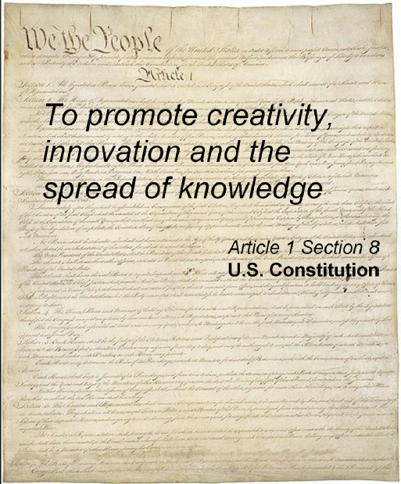
The core purpose of copyright law is not difficult to find; it is stated expressly in the Constitution.
Article I, section 8, clause 8 of the United States Constitution provides that Congress shall have the power: "to promote the Progress of Science and useful Arts, by securing for limited times to Authors and Inventors the exclusive Right to their respective Writings and Discoveries."
Copyright’s for the people,
Copyright’s to promote creativity,
Balancing rights of users
And owners of intellectual property…….

Slide 4
opyright Larity
Copyright, what’s copyright?
It’s the right of the owners to control!
Right?
No!
Copyright’s for the people.
Copyright’s to promote creativity.
Balancing rights
of users
And owners of intellectual property.

Slide 5
gi
Copyright gives the creators sole rights:
For production,
For adaption,
For distribution,
For public performance, &
For public displays of their work.
Copyright also promotes creativity!
It does this with the addition of The Copyright Act.
The Copyright Act provides that certain kinds of uses of copyrighted works, called FAIR USES, are
not an infringement of copyright, despite the fact that
their use may involve copying, adapting, performing, or
displaying the copyrighted work.
opyright larity

Slide 6
fair use is here!
Fair use explicitly allows use of copyrighted material for educational purposes such as:
*criticism
*comment
*news reporting
*teaching
*scholarship
*research
Fair use is not a blank check to use anything you like because you are a teacher.
There are four factors to consider when deducing if use of copyrighted material is a fair use and thus not an infringement.
GOOD NEWS!
FAIR USE
IS HERE

Slide 7
Four factors when using FAIR USE:
THE PURPOSE AND CHARACTER OF THE USE.
This is the TRANSFORMATIVE FACTOR. Did you copy the work verbatim or did you transform it and
add new expressions, or create new insight?
THE NATURE OF THE WORK.
Is the work factual, nonfiction? If so it is more favorable for Fair Use.
Creative work needs to be closely looked at .
THE PROPORTION OF MATERIAL USED.
Less is better! There are no real numerical or percentage limits that are
governed by law. Charts can provide a false sense of security, they are just suggestions. Important rule of thumb, try not to use the most memorable parts.
THE EFFECT OF THE USE ON MARKET VALUE.
Are you depriving the copyright owner of income? Will there be a reduction of in sales due to copying or redistribution.

Slide 8
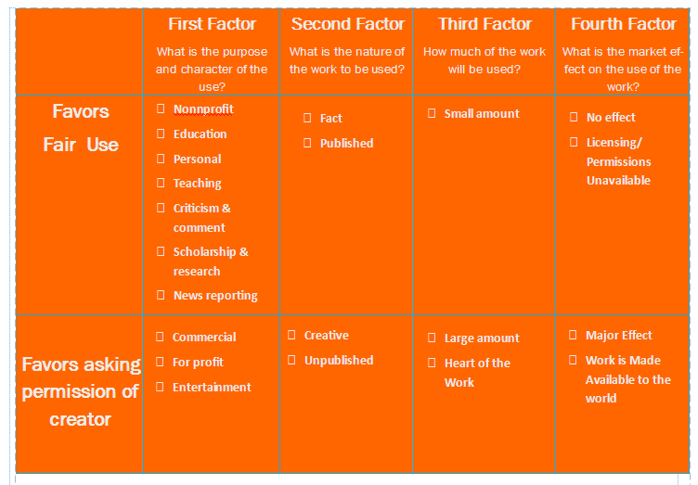
Here’s a quick Chart: Use this chart to check for Fair use or for Permission.
REMEMBER A GOOD RULE OF THUMB, IF ONE BOX IS CHECKED IN THE
ASKING PERMISSION ROW, THEN ITS BETTER TO BE SAFE THAN SORRY.

Slide 9
Here are a few more things as educators, we should know:
We must understand the basics of copyright.
We have a responsibility to model compliance to copyright.
We should always ask for permission to use works that are likely not fair use.
Asking for permission to use is always a good option.
We must insure that students use information for projects in an ethical manner.
Citing a work is not the same as having permission to use the work.
Copying a work and changing a few words is not fair use.
Movies shown as a reward do not qualify as fair use.
Rampant duplication of materials instead of purchasing instructional materials is not fair use (effect on the market).

Slide 10
Let’s Test our Understanding?
Scenario:
1) The Gaming Club at your high school wants to throw a fundraiser and show a marathon of Naruto cartoons on the big screen, What do you say?
2) A teacher or student prepares and gives a presentation that displays photographs. Permission was not obtained to use the photographs. Can they do this legally?
3) A student creates a prezi for a class presentation. There is a copyrighted popular song playing in the background of the prezi. Is this okay?

Slide 11
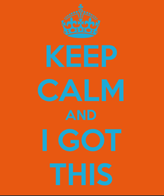
Were you right?
Scenario:
1) No, because it infringes the copyright owner's right to market the work.
2) Yes, thank you fair use. Copyrighted photographs may be used for instruction.
3) Yes, thank you fair use. Copyrighted music may be used for instruction.

Slide 12
Work cited
The Code of Best Practices in Fair Use for Media Literacy Education. (2013). Retrieved June 30, 2013, from Center for Social Media website: http://www.centerforsocialmedia.org/fair-use/related-materials/codes/code-best-practices-fair-use-media-literacy-education
Copyright Basics. (2013). Retrieved June 30, 2013, from BYU Copyright Liscensing Office website: http://lib.byu.edu/sites/copyright/about-copyright/basics/
Copyright Basics: Introduction. (2008). Retrieved June 30, 2013, from The campus guide to copyright compliance website: http://www.copyright.com/Services/copyrightoncampus/basics/
Understanding copyright. (2012). Retrieved from University of Rhode Island Harrington School Media Lab website: http://mediaeducationlab.com/section-1-understanding-copyright

